Slide 1





North Wales Integrated Substance Misuse Service

Slide 2
Reduce risk of harm from substance misuse and re-offending to self and the wider community

Slide 3
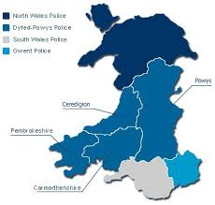



The Wales Wide Picture

Slide 4
Referral and Entry Points
referrals.nw@kaleidoscope.cjsm.net
nwspoc@kaleidoscopeproject.org.uk
Tel: 01492 556776
Fax: 01495 849903

Slide 5
Arrest referral
Pre Sentence Reports / Fast Track Delivery Reports / Verbal advice and guidance
  Alcohol Treatment Requirements
  Drug Rehabilitation Requirements
  Community sentence planning
  Required Activities - ORA
  Post release licence monitoring – ORA
CJ case management – for court ordered interventions including feedback and enforcement information
Contribution to multiagency risk management models
  IOM
  WISDOM
  MARAC
  MAPPA
  SVOC
  Safeguarding / MDT and case conferences
Drug Screen testing - urine and oral
Group and 1:1 interventions
Recovery Support and onward referral

Slide 6
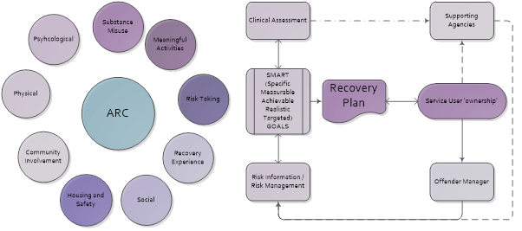
Recovery Service

Slide 7

Clinical Services
  Opiate Substitute Therapy (Buprenorphine / Methadone)
    Drug Rehabilitation Requirements
    Prison Leavers – up to 12 weeks
  Assessment and support for onward referral
    Alcohol detox
    Tier 4
    Naloxone
    BBV
    NPS – and health and wellbeing advice and harm reduction – shared learning / trends and medical management from other clinical services.

Slide 8

COVID challenge leading to SUCCESS!
Court and prison assessment
  Physical presence
  Video link
  Telephone support
  Telephone assessment
  Balance and checks
Homelessness
  Temporary accommodation
  Short notice arrangements
Self isolation and shielding
  Staff
  Service users
Building COVID risk management
  Community venues
  Partner buildings
  Shared premises

Slide 9

Digital inclusion
  Digital exclusion
  Online support packages / recovery groups and mutual aid.
  1:1 via social media apps, video link and more.
Access to mobile phone
Wrap around heath and wellbeing
Tier 4 referrals – detox and rehab
Pharmacy / community collection and liaison
Third party collection
Outreach and home visits

Slide 10





Remote Working
Rota staff
Lone working
Outreach
Home visits
Sharing successes and seeking support when there are challenges.
Isolation
Technical challenges!

Slide 11
Numbers…
2019/2020 Affinity Partnership Criminal Justice Service received 1179 referrals.
April – November 2020 Dechrau Newydd has received 583 referrals
334 Prison Referrals
106 Court Assessments
143 via other community and CJ routes
196 prescribing places have been allocated.
Todays update:
  73 active service users are receiving their prescriptions from us
  212 service users accessing support and interventions in the community

Slide 12

(SROI) Social Return
On Investment
Social Value Cymru
2019/2020

Slide 13




Slide 15
Next Steps…..
Continue COVID recovery implementation plans safely and with service user recommendations and feedback driving our priorities.
Support and develop response to the Female Offending Blueprint, Specialist Support centres for female offenders and inform our third sector partners.
Develop and improve remote links for court and remand service users who request or are referred for drug and alcohol assessment to inform sentencing and licence planning.
Build on experiences of on line delivery - peer support, health and wellbeing, learning and skills groups.
Recruit, support and mobilise peer led engagement and activities through volunteering and service user engagement
Harm Reduction Innovation – the wider drug policy agenda and new technology.

Slide 16
Thankyou to all our partners!

